Slide 1
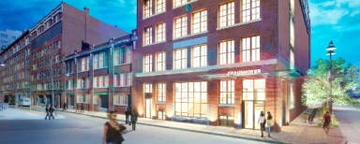
CSE Renovation Project
Boston, MA
Xiaoyin Wu (Laura)
Lighting/Electrical | Architectural Engineering | Penn State University

Slide 2
PROJECT OVERVIEW
LOBBY LIGHTING DESIGN
OFFICE REDESIGN
ELECTRICAL DEPTH
SUMMARY

Slide 3
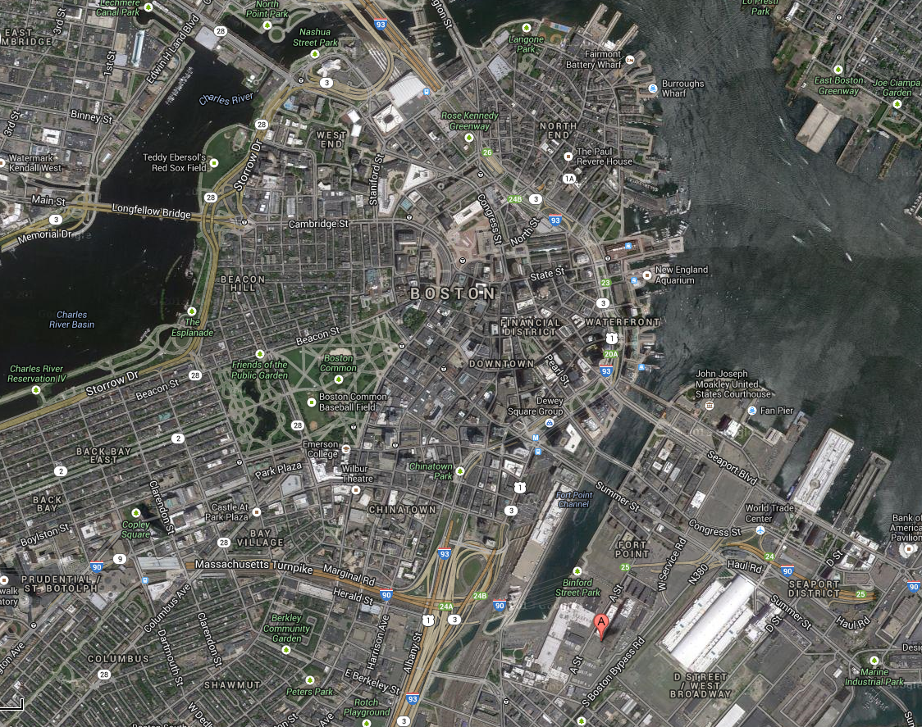
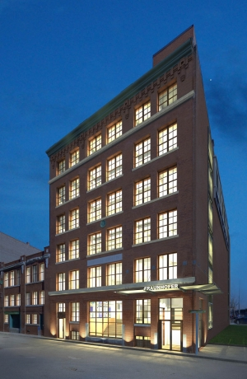
Project Overview
Building Name-
Location-
Occupancy Type-
Size-
Stories above Grade-
Fraunhofer CSE
5 Channel Center Street, Boston, MA
Offices and research laboratories (Group B) Conference room (Group A-3)
42150SF
6

Slide 4
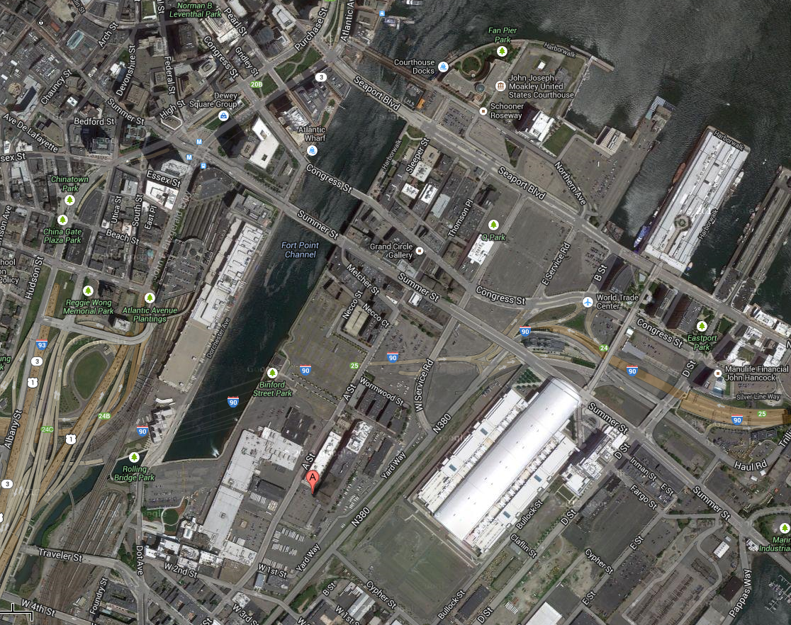
Project Overview
Building Name-
Location-
Occupancy Type-
Size-
Stories above Grade-
Fraunhofer CSE
5 Channel Center Street, Boston, MA
Offices and research laboratories (Group B) Conference room (Group A-3)
42150SF
6

Slide 5
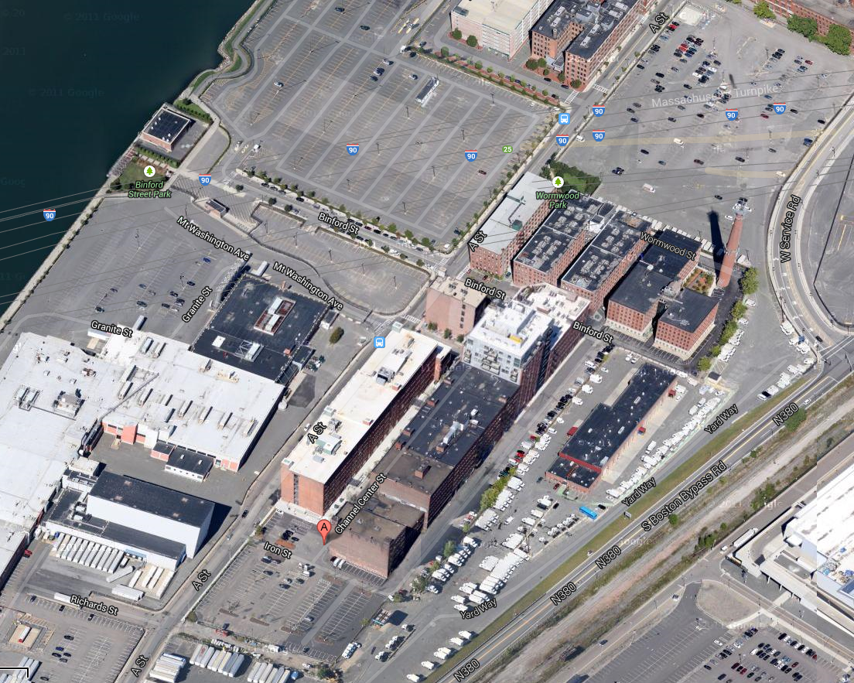
Project Overview
Building Name-
Location-
Occupancy Type-
Size-
Stories above Grade-
Fraunhofer CSE
5 Channel Center Street, Boston, MA
Offices and research laboratories (Group B) Conference room (Group A-3)
42150SF
6

Slide 6
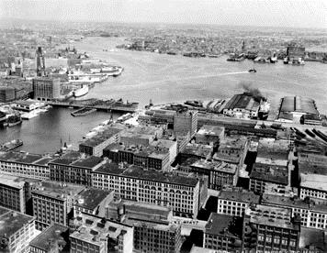
a renovation for a 100-year old historical building classical revival-style detailing
the Fort Point Channel district is marked by an exceptional degree of visual uniformity
buildings are elegantly proportioned, with classically inspired details concentrated at entrances and cornices the structure is left unchanged in this project to conserve the significant continuity throughout the District in terms of massing, scale, and style

Slide 7
OUTLINE
Design Concept
scope of work
lobby lighting design
office
architecture breadth
lighting design
electrical depth
Based in Boston, MA, the Fraunhofer Center for Sustainable Energy Systems (CSE) is an applied research and development laboratory dedicated to the commercialization of CLEAN energy TECHNOLOGY. CSE engages in COLLABORATIVE research and development with private companies, government entities, and academic institutions, performing research that broadly benefits firms, industries, and society.
CLEAN
TECHNOLOGY
COLLABORATIVE
LIGHTING DESIGN OBJECTIVES
Notes:
Fraunhofer CSE housed a group of people who are passionate about clean energy research and they are doing great work to promote this kind of product and concept into everyday life. So I think they deserve to have a

Slide 8
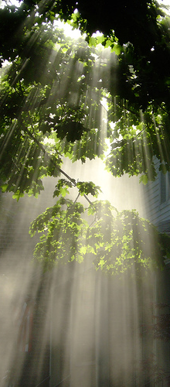
OUTLINE
Design Concept
scope of work
lobby lighting design
office
architecture breadth
lighting design
electrical depth
REFRESH
DESIGN IDEAS
Notes:
In order to visualize those objectives into some image form of concepts, I found some picture that really inspire my design.

Slide 9
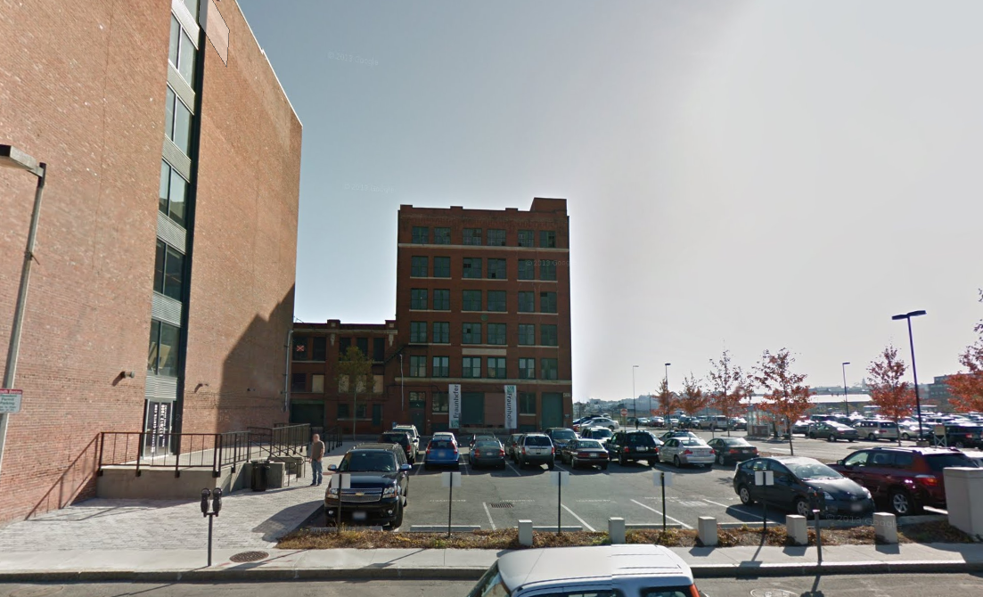
OUTLINE
Design Concept
scope of work
lobby lighting design
office
architecture breadth
lighting design
electrical depth
What you expect to see before you enter the building
Vs.
What you WILL see when you entered
DESIGN IDEAS
Notes:
After I decided on my design concept, the question left for now is, how do I want to apply the concept into the design itself. I then ask a question about the expectation for the building and how the I can blow people people’s mind by utilizing lighting design. wait and see. And you will find another building inside of the 100 year of historical building.

Slide 10
OUTLINE
design concept
Scope of Work
lobby lighting design
office
architecture breadth
lighting design
electrical depth
Lighting Redesign
Lobby
Conference Room
Open Office
Façade
Electrical Depth
Branch Circuit Redesign and Feeder Resizing
PV Economical Analysis
Breadth
Architecture
Structure
SCOPE OF WORK
Notes:
But instead of design the whole building, four spaces are chosen to represent my ideas.

Slide 11
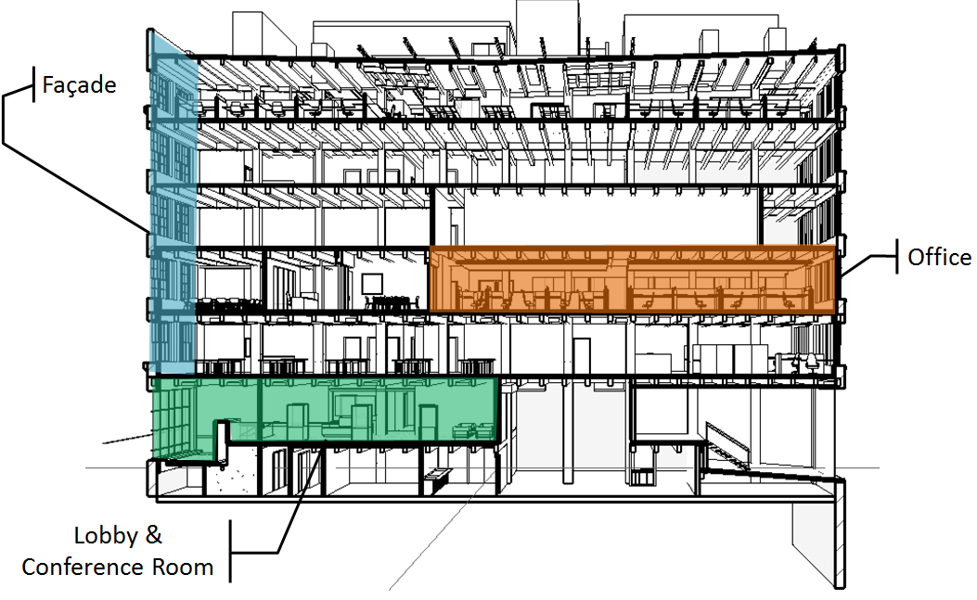
OUTLINE
design concept
Scope of Work
lobby lighting design
office
architecture breadth
lighting design
electrical depth
Lighting Redesign
LOBBY
Conference Room
OPEN OFFICE
Façade
Electrical Depth
Branch Circuit Redesign And Feeder Resizing
PV ECONOMICAL ANALYSIS
Breadth
ARCHITECTURE
Structure
PRESENTATION COVERAGE
Notes:
And in the presentation, I will only talk about….

Slide 12
OUTLINE
design concept
scope of work
Lobby Lighting Design
office
architecture breadth
lighting design
electrical depth
LOBBY

Slide 13
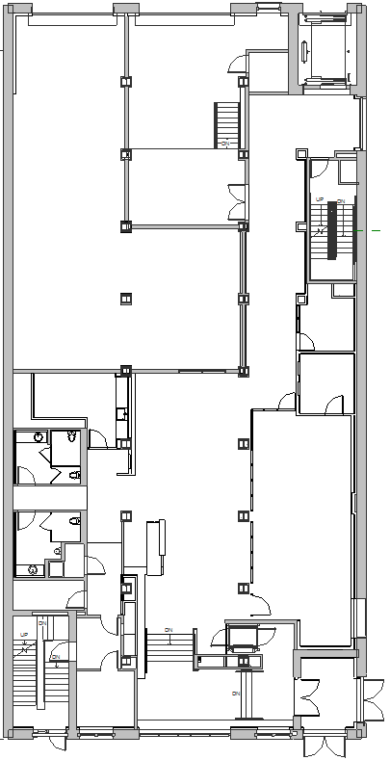
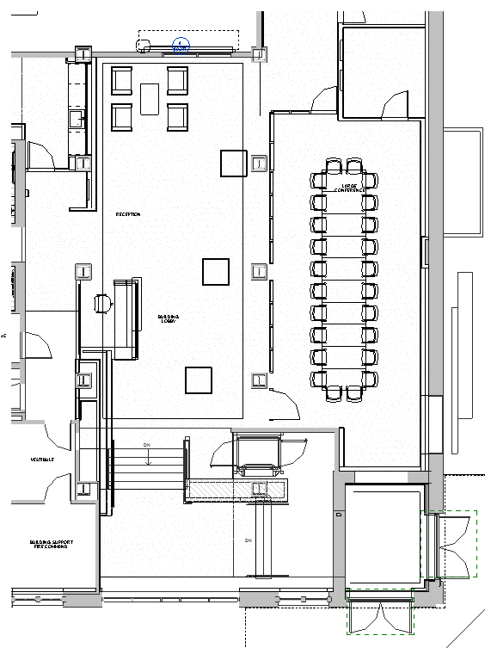
OUTLINE
design concept
scope of work
Lobby Lighting Design
office
architecture breadth
lighting design
electrical depth
Width: 19’-10”
Length: 47’-8”
Height: 8’-10 ¼
LOBBY

Slide 14
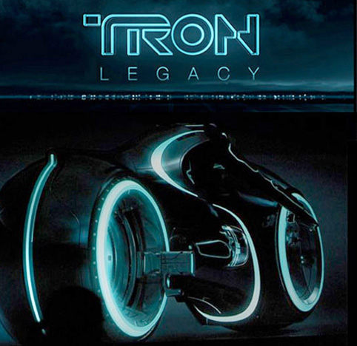
OUTLINE
design concept
scope of work
Lobby Lighting Design
office
architecture breadth
lighting design
electrical depth
Visual Considerations
Appearance
Accenting
Flexibility
Way finding/Orientation
Quality Lighting
100lux horizontally
avg:min = 4:1
Gateway from history to the contemporary
LOBBY

Slide 15
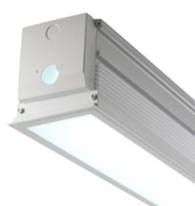
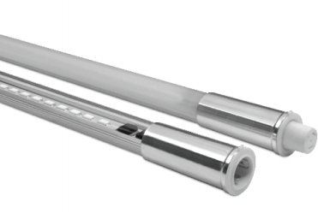
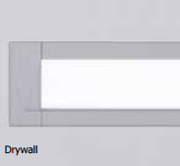
OUTLINE
design concept
scope of work
Lobby Lighting Design
office
architecture breadth
lighting design
electrical depth
LUMIANIRES

Slide 16
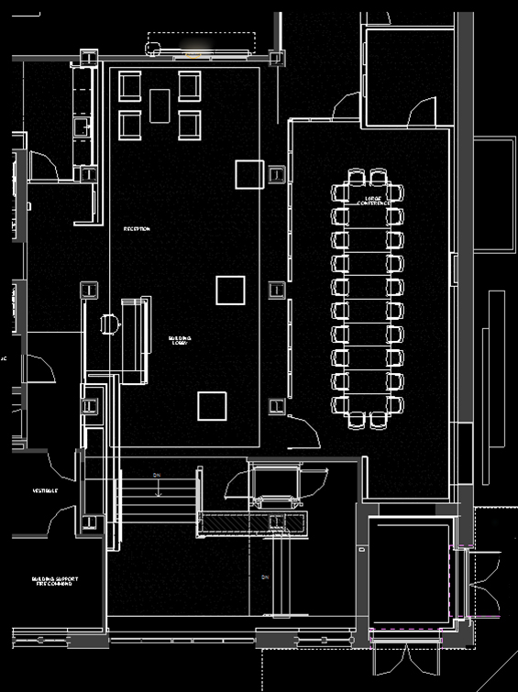
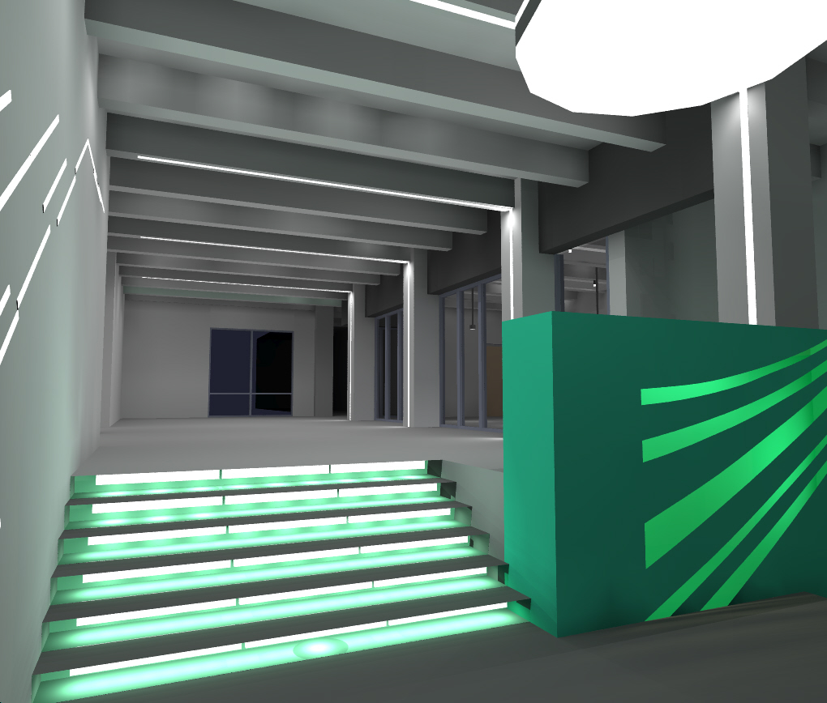
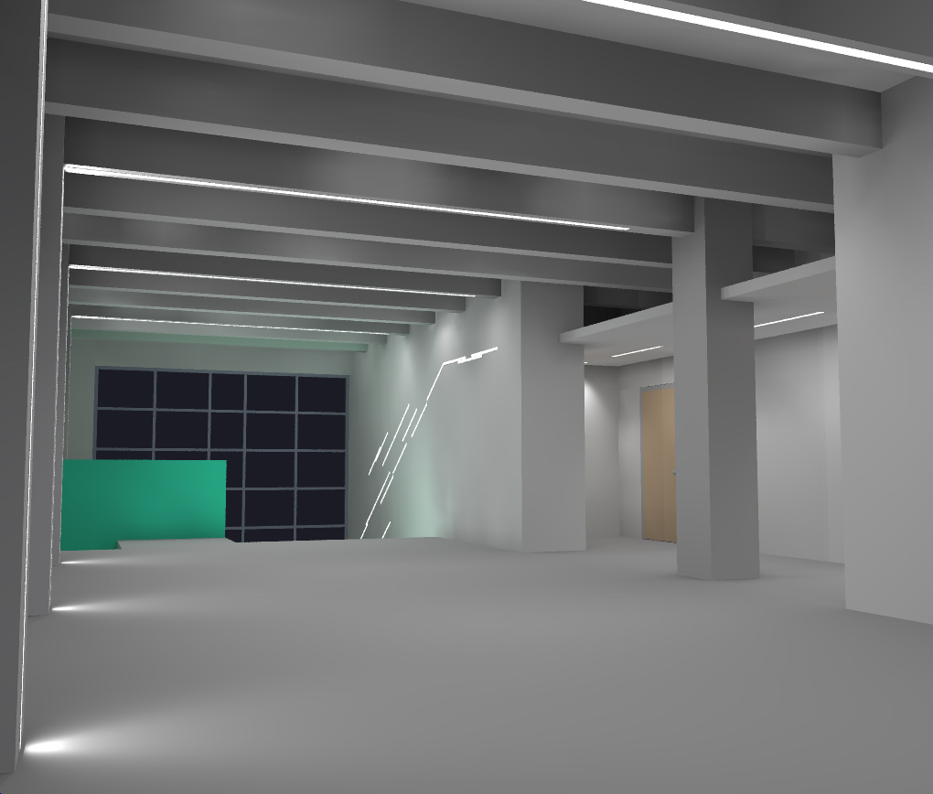
OUTLINE
design concept
scope of work
Lobby Lighting Design
office
architecture breadth
lighting design
electrical depth
RENDERINGS

Slide 17
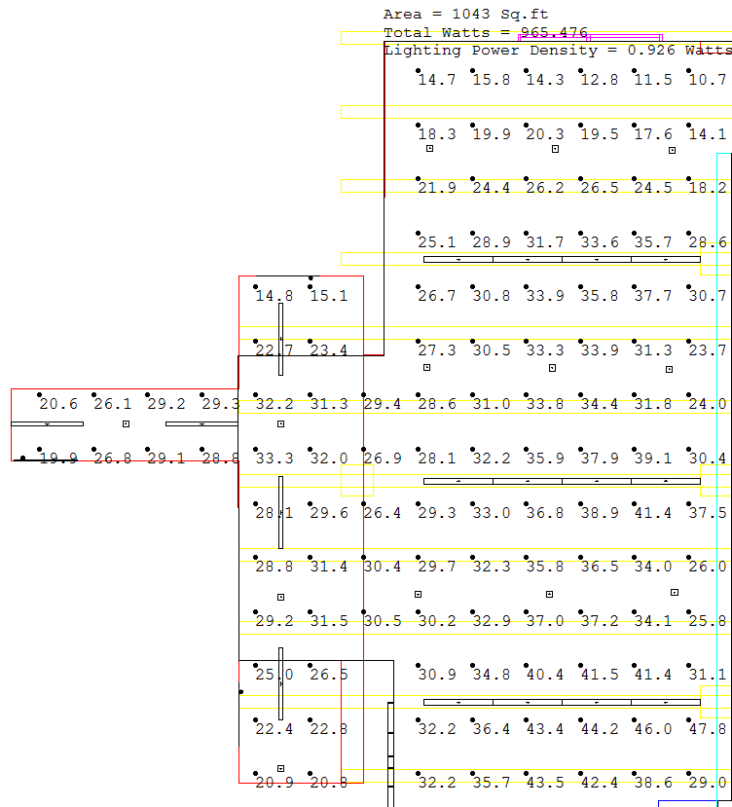
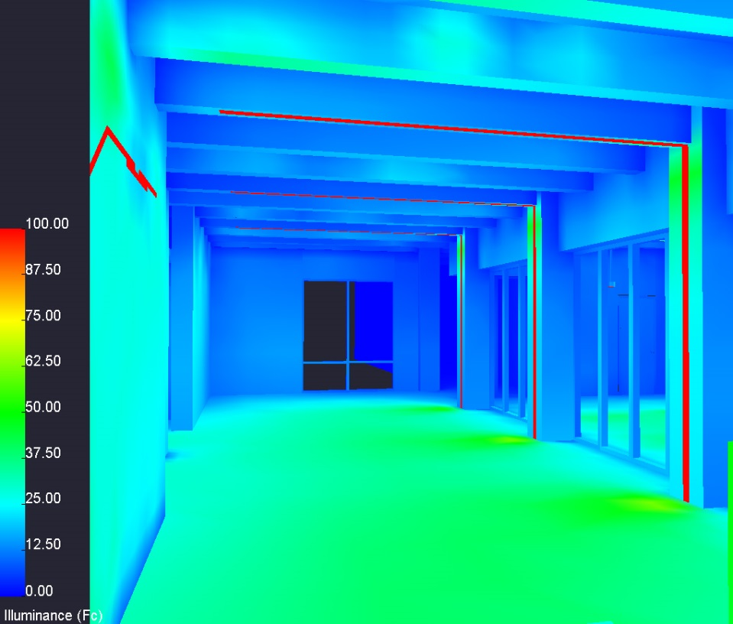
OUTLINE
design concept
scope of work
Lobby Lighting Design
office
architecture breadth
lighting design
electrical depth
Average Illuminance | 29.5Fc
Avg : Min | 2.76
CALCULATION

Slide 18
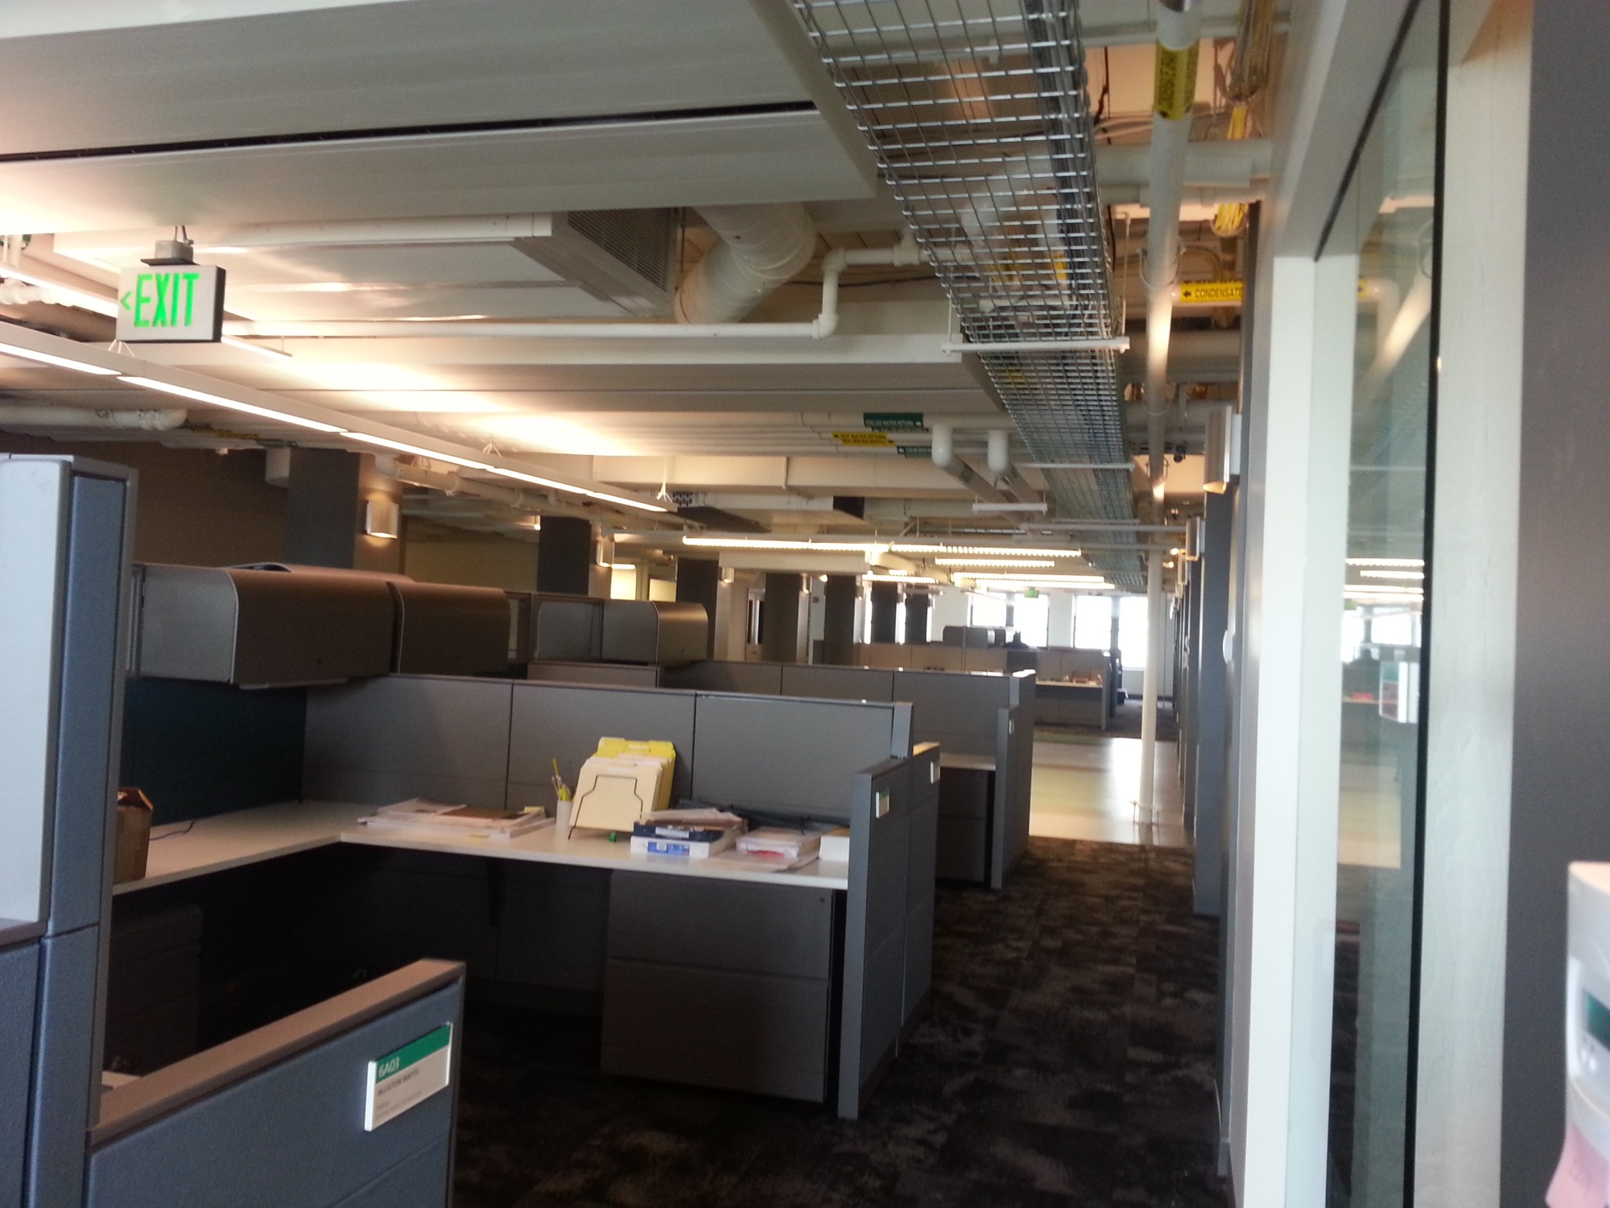
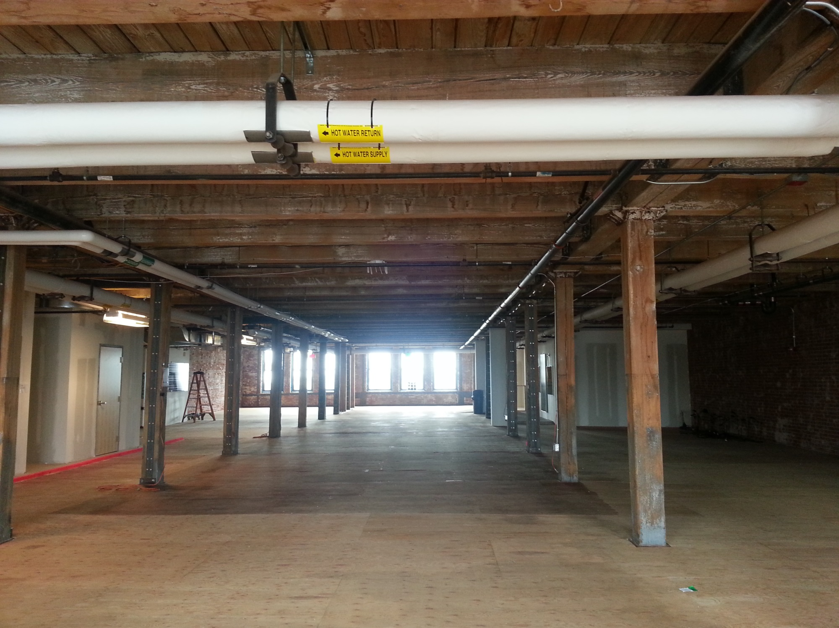
OUTLINE
design concept
scope of work
lobby lighting design
Office
architecture breadth
lighting design
electrical depth
3rd FLOOR OFFICE
OFFICE

Slide 19
OUTLINE
design concept
scope of work
lobby lighting design
Office
Architecture breadth
lighting design
electrical depth
open
office
OFFICE

Slide 20
OUTLINE
design concept
scope of work
lobby lighting design
Office
Architecture breadth
lighting design
electrical depth
“Practical, aesthetic, and conducive to intended purposes, such as raising productivity, selling merchandise, or improving life style."
-- U.S. Bureau of labor Statistics
Interior design is a practice that responds to changes in the economy, organization, technology, demographics, and business goals of an organization.
OPEN
office
Brighten Your Everyday
ARCHITECTURE DESIGN OBJECTIVES
Notes:
Mention about how the contract of the classical look of the exterior and the modern look of the interior, makes the user always feel refresh of the building. And the
The design concept also relates to the lighting design concept of the sunlight beams as well

Slide 21
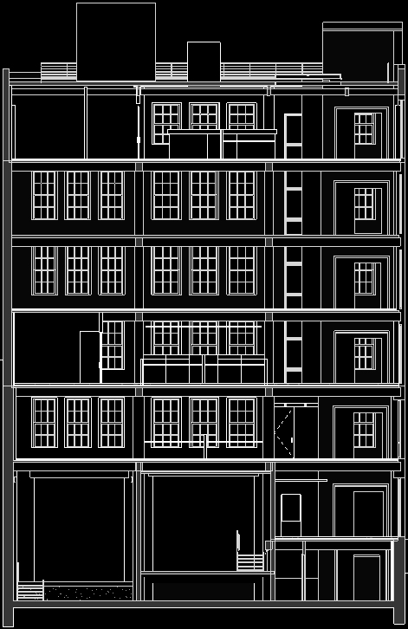
OUTLINE
design concept
scope of work
lobby lighting design
Office
Architecture breadth
lighting design
electrical depth
OPEN
office
Affecting Floors
3rd floor office area
Brighten Your Everyday
ARCHITECTURE BREADTH

Slide 22
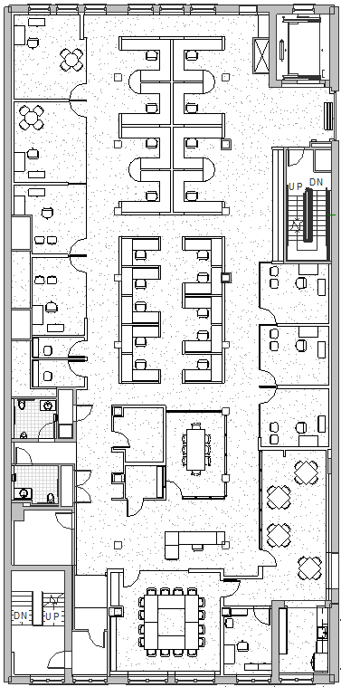
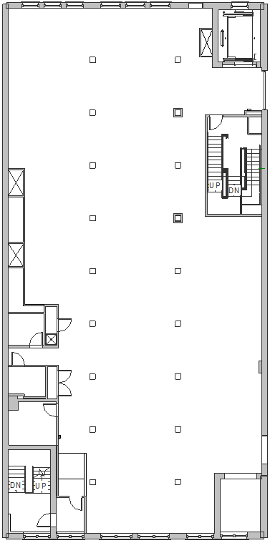
OUTLINE
design concept
scope of work
lobby lighting design
Office
Architecture breadth
lighting design
electrical depth
3rd floor
4th floor
5th floor
ARCHITECTURE BREADTH

Slide 23
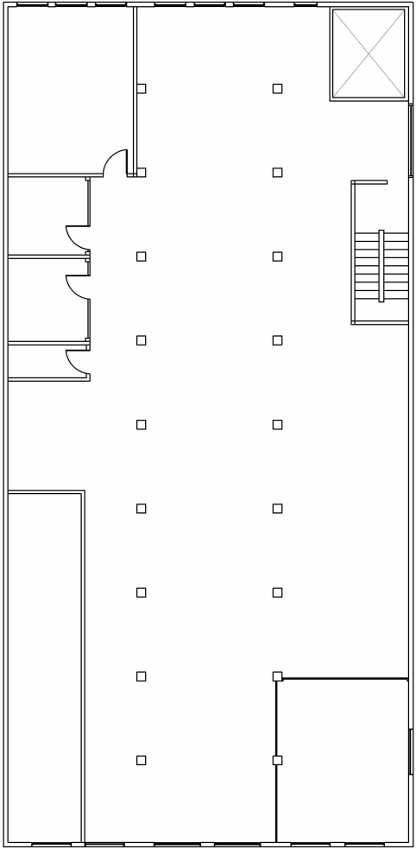
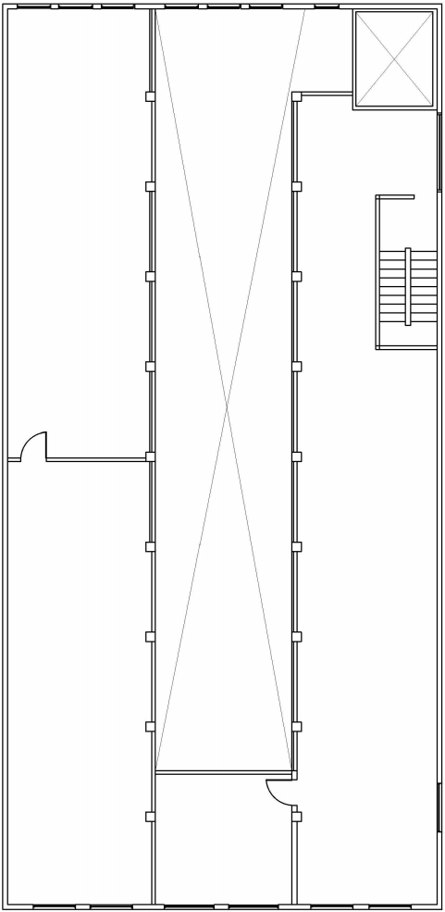
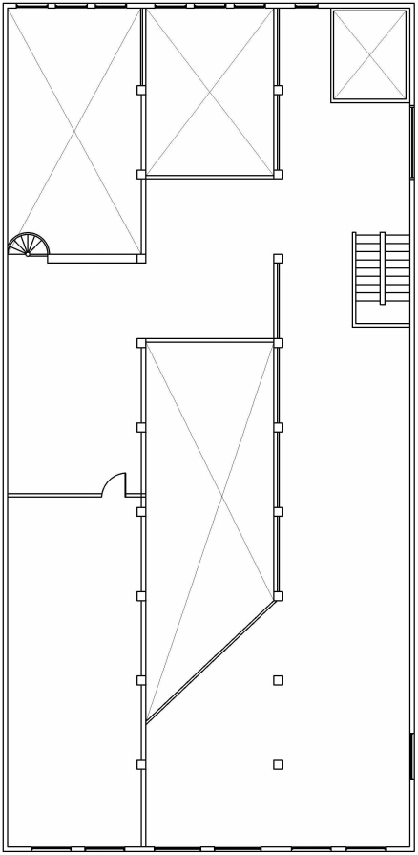
OUTLINE
design concept
scope of work
lobby lighting design
Office
Architecture breadth
lighting design
electrical depth
3rd floor
4th floor
5th floor
ARCHITECTURE BREADTH

Slide 24
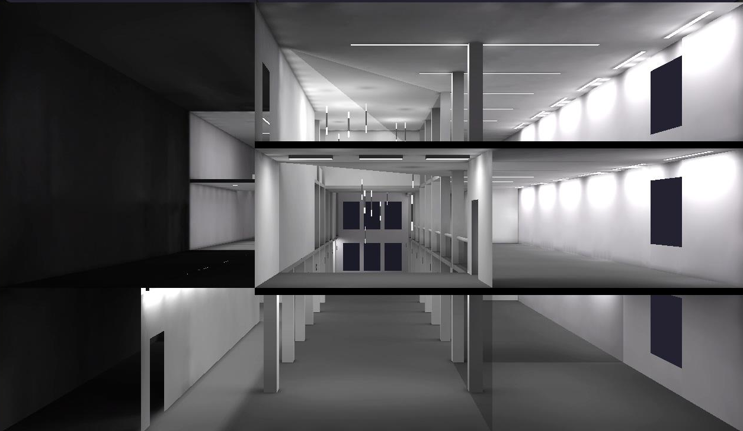
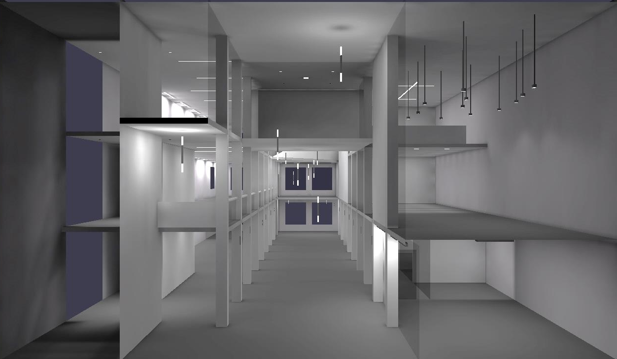
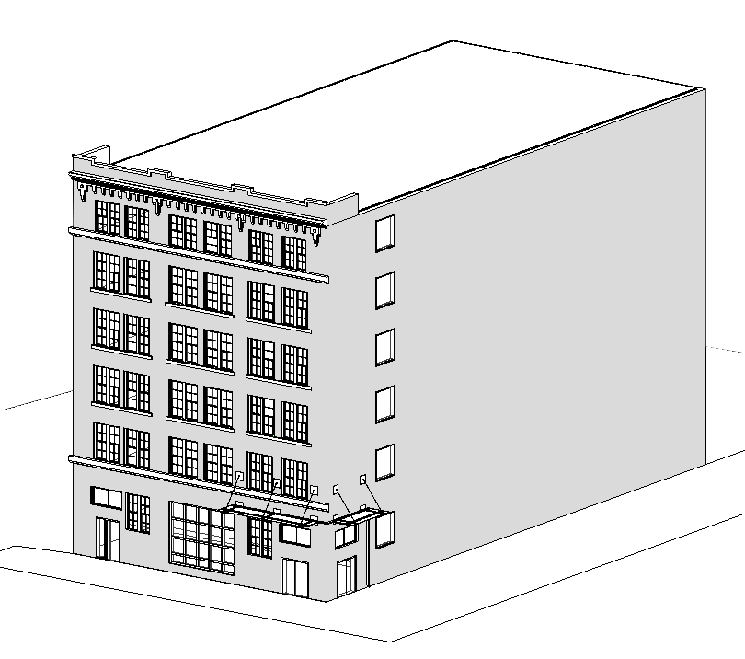
OUTLINE
design concept
scope of work
lobby lighting design
Office
Architecture breadth
lighting design
electrical depth
ARCHITECTURE BREADTH

Slide 25
OUTLINE
design concept
scope of work
lobby lighting design
Office
architecture breadth
Lighting design
electrical depth
Visual Considerations
Task oriented
Flexibility
Appearance
Quality Lighting
150lux horizontally
avg:min = 1.5:1
OFFICE LIGHTING REDESIGN
LIGHTING CRITERIA

Slide 26
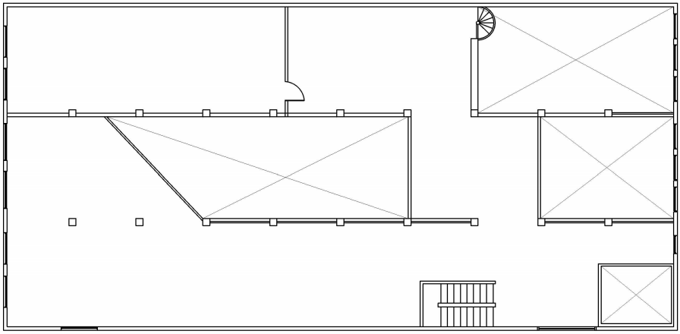
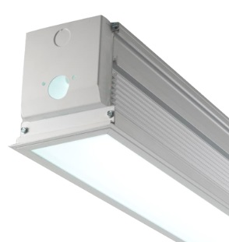
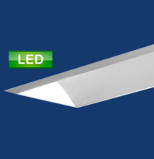
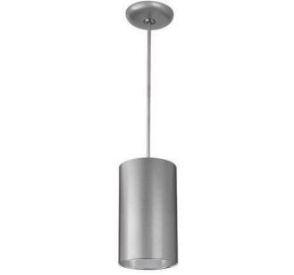
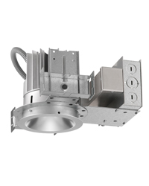
OUTLINE
design concept
scope of work
lobby lighting design
Office
architecture breadth
Lighting design
electrical depth
LUMINAIRES

Slide 27
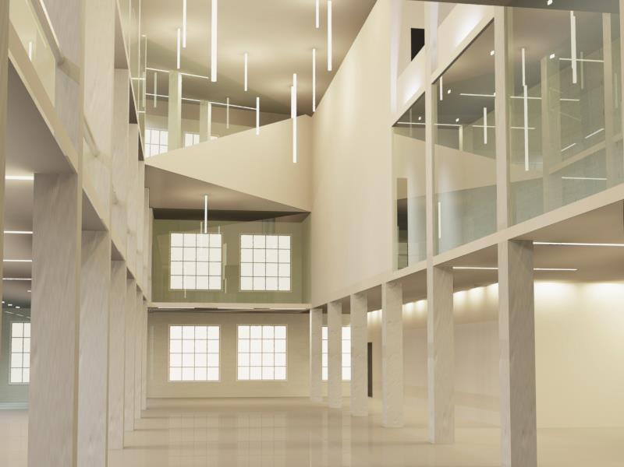
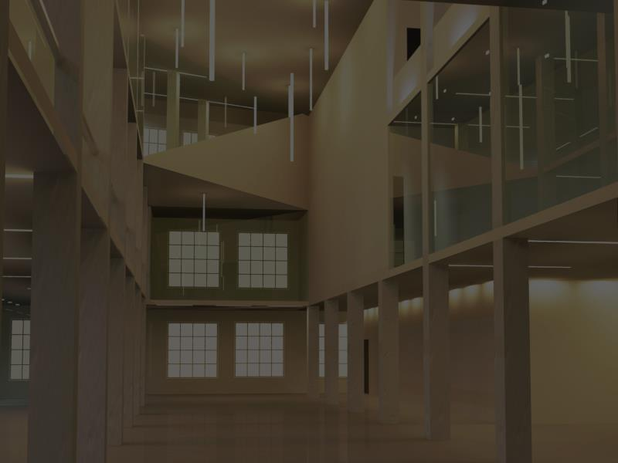
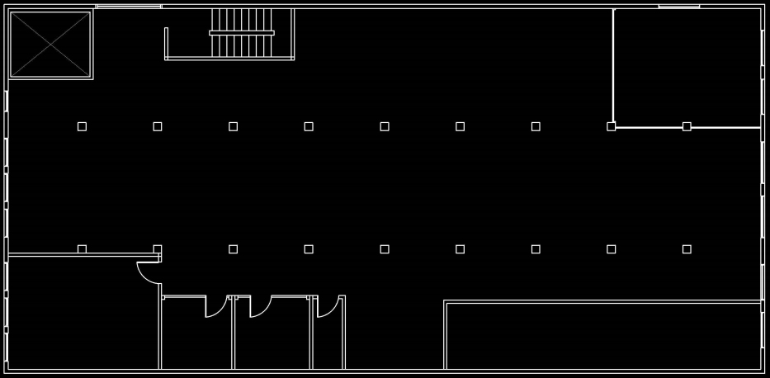
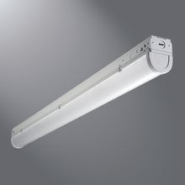
OUTLINE
design concept
scope of work
lobby lighting design
Office
architecture breadth
Lighting design
electrical depth
Center Atrium
Average Illuminance 16.7Fc
Max Illuminance
24Fc
Max/Min
4.2
RENDERINGS + CALCULATIONS
Notes:
I used a quite literal way to represent the light beams through the tree braches

Slide 28
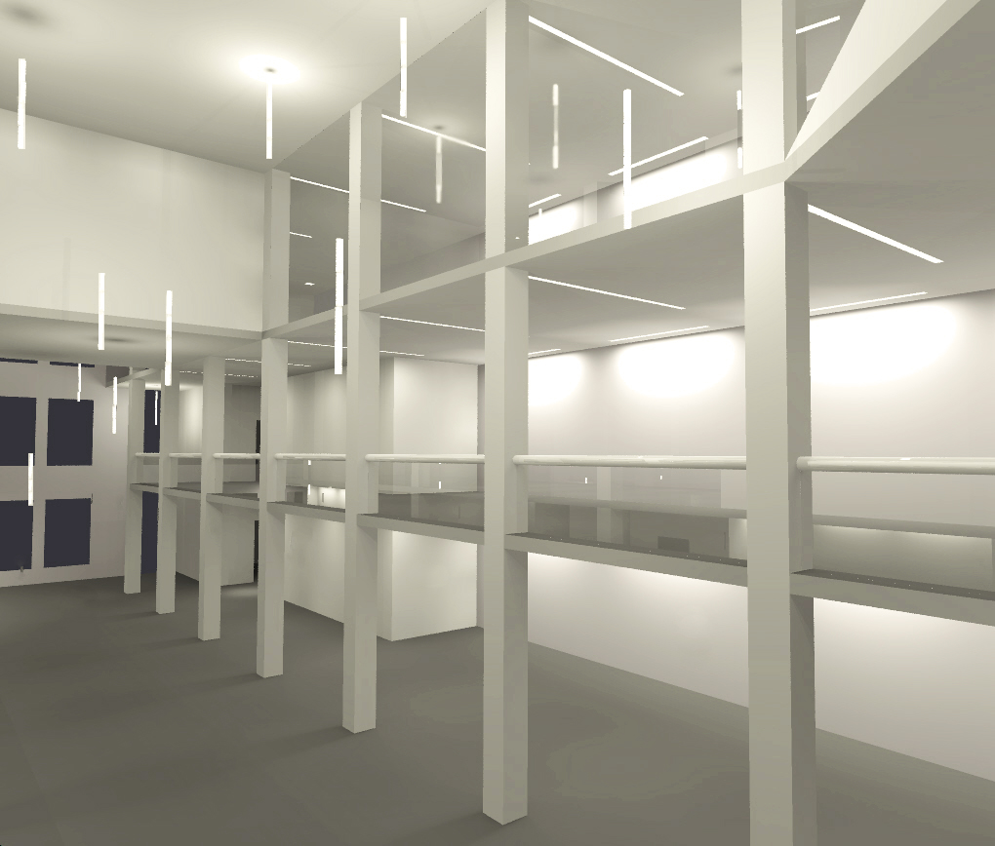
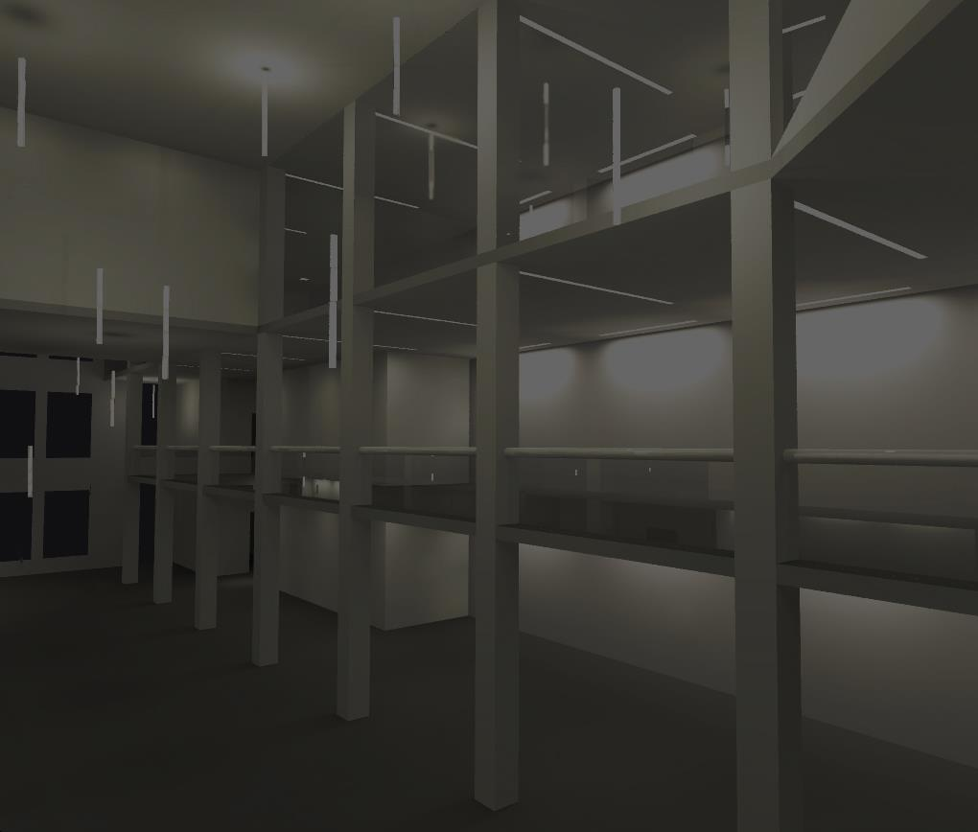
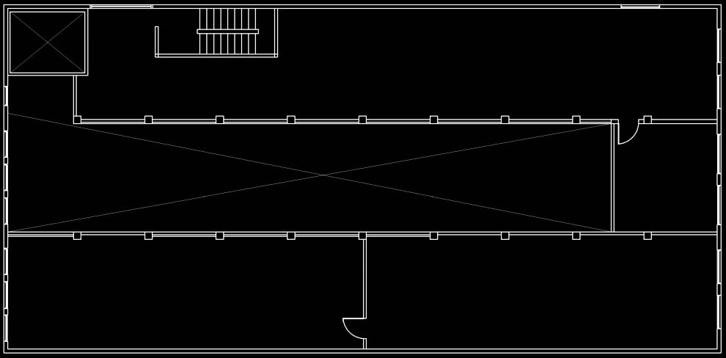
OUTLINE
design concept
scope of work
lobby lighting design
Office
architecture breadth
Lighting design
electrical depth
2nd level side office
Average Illuminance 22.8Fc
Max Illuminance
33Fc
Max/Min
1.6
RENDERINGS + CALCULATIONS

Slide 29
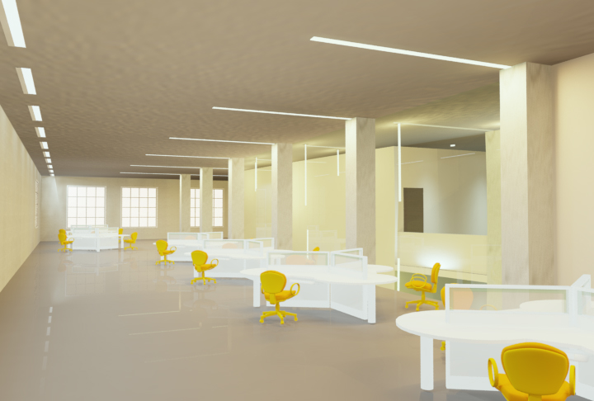
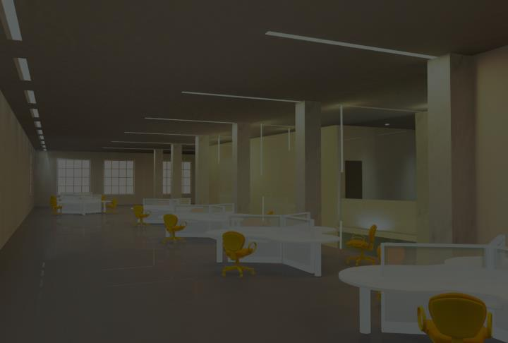
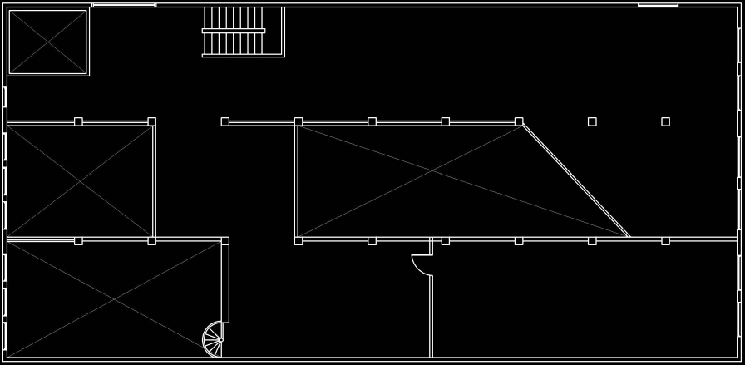
OUTLINE
design concept
scope of work
lobby lighting design
Office
architecture breadth
Lighting design
electrical depth
3rd level side office
Average Illuminance 22.4Fc
Max Illuminance
33.5Fc
Max/Min
1.8
RENDERINGS + CALCULATIONS

Slide 30
OUTLINE
design concept
scope of work
lobby lighting design
office
architecture breadth
lighting design
Electrical Depth
ELECTRICAL SYSTEM
ELECTRICAL DEPTH

Slide 31
OUTLINE
design concept
scope of work
lobby lighting design
office
architecture breadth
lighting design
Electrical Depth
Penal Board | Lighting (VA) | Receptacle (VA) | Equipment (VA)
P2B | 0 | 27000 | 4576
P22 | 770 | 31000 | 15476
P23 | 883 | 21140 | 24400
P21B | 8233 | 12140 | 12504
P24 | 4524 | 800 | 0
P25 | 800 | 0 | 2400
P26 | 1800 | 36500 | 21080
L42 | 20920 | 0 | 0
L44 | 4299 | 0 | 0
P32 | 0 | 0 | 11200
P22A | 0 | 0 | 40292
EP4B | 12033 | 0 | 92520
P21A | 0 | 0 | 600
P2P | 0 | 1800 | 8700
EP2B | 1080 | 1500 | 6584
Total (kVA) | 55.342 | 131.88 | 240.332 | 427.554
Array Area | 1300 sf
PV rate | 100w/sf
Total watt per array | 130kw
Total Load usage per year | 14.8kw
PV cost/watt | $1.4/w
PV cost per year | $14800
Watt save per year | 130kw
Conventional Power | $17619
 | ($2819)
NSTAR Peak Demand Rate = $28.62/kW (per month) Electric Rate: $0.08145/kWh Delivery Charge = $115/month (flat rate)
ELECTRICAL DEPTH

Slide 32
Lighting redesign of the spaces achieved the design goals of providing the spaces quality lighting as well as a modern new appearance while saving energy the same time.
The electrical part is altered according to the new design of lighting and control load. Since the building is not completely finished of the retrofit process, the load is slightly higher than the current load due to the vacant of two stories.
The architecture breadth has a cohesive design with the lighting design in the office space. And it accomplished the goal of creating a better working environment.
SUMMARY
Notes:
Reference Page

Slide 33
SPECIAL THANKS TO:
Fruanhofer CSE
Dr. Kurt Roth
Philips
Ms. Dorene Mannicia
Mrs. Carol Jones
Ms. Meg Smith
DiMella Shaffer
Mr. J. Cruz
Penn State
Mr. Shawn Good
Ms. Leslie Beahm
Dr. Kevin Houser
Dr. Richard Mistrick
Dr. Charles Cox
Professor Kevin Parfitt
And thanks to my parents, fellow AEs and friends for the best support I could ask for
ACKNOWLEDGEMENTS
Notes:
Reference Page

Slide 34
QUESTIONS?
Notes:
Reference Page

Slide 35
Customer (per month) $18.19 | Distribution Energy First 2,000 kWh (per kWh) $0.02419 | Distribution Energy Next 150 hours of kW (per kWh) $0.01914
Distribution Energy Each additional kWh (per kWh) $0.01727 | Distribution Demand Greater than 10 kW (per kW) $9.43 | Transition Energy First 2,000 kWh (per kWh) $0.00783
Transition Energy Next 150 hours of kW (per kWh) $0.00783 | Transition Energy Each additional kWh (per kWh) $0.00783 | Transition Demand (per kW) No Charge
Transmission Demand Greater than 10kW (per kW) $5.54 | Transmission Energy First 2,000 kWh (per kWh) No Charge | Transmission Energy Next 150 hours of kW (per kWh) No Charge
Transmission Energy Each additional kWh (per kWh) No Charge | Energy Conservation (per kWh) $0.00250 | Renewable Energy (per kWh) $0.00050
Customer (per month) $18.19 | Distribution Energy First 2,000 kWh (per kWh) $0.03412 | Distribution Energy Next 150 hours of kW (per kWh) $0.02087
Distribution Energy Each additional kWh (per kWh) $0.01776 | Distribution Demand Greater than 10 kW (per kW) $20.22 | Transition Energy First 2,000 kWh (per kWh) $0.00783
Transition Energy Next 150 hours of kW (per kWh) $0.00783 | Transition Energy Each additional kWh (per kWh) $0.00783 | Transition Demand (per kW) No Charge
Transmission Demand Greater than 10kW (per kW) $14.68 | Transmission Energy First 2,000 kWh (per kWh) No Charge | Transmission Energy Next 150 hours of kW (per kWh) No Charge
Transmission Energy Each additional kWh (per kWh) No Charge | Energy Conservation (per kWh) $0.00250 | Renewable Energy (per kWh) $0.00050
APPENDICES
Notes:
Reference Page

Slide 36
APPENDICES
http://www.nrel.gov/
Notes:
Reference Page

